Slide 1
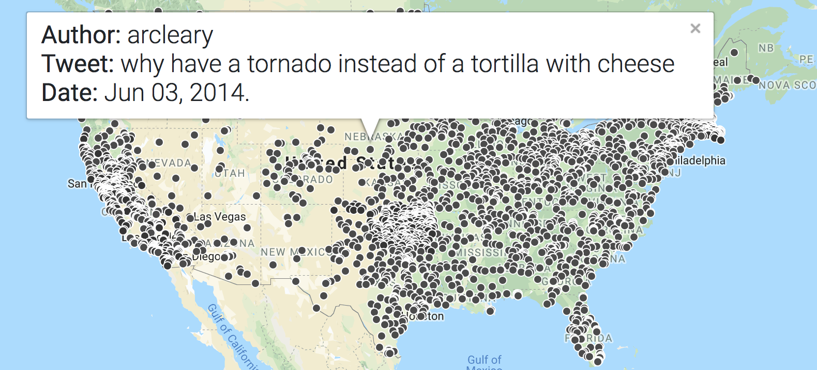
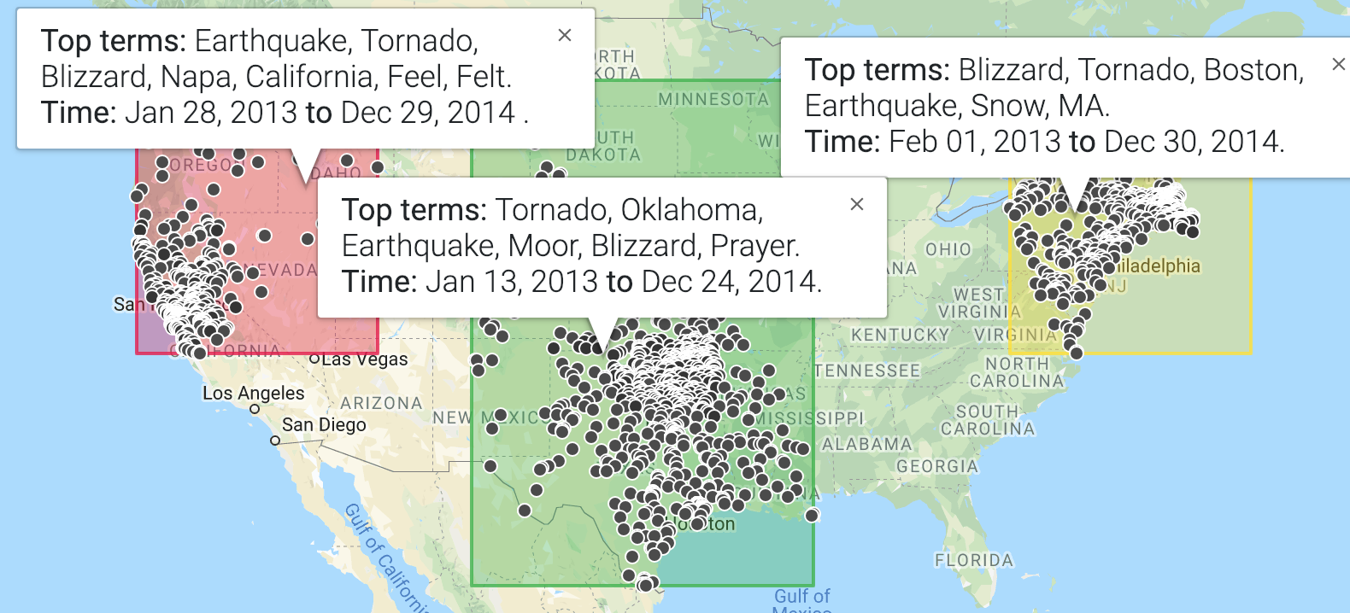
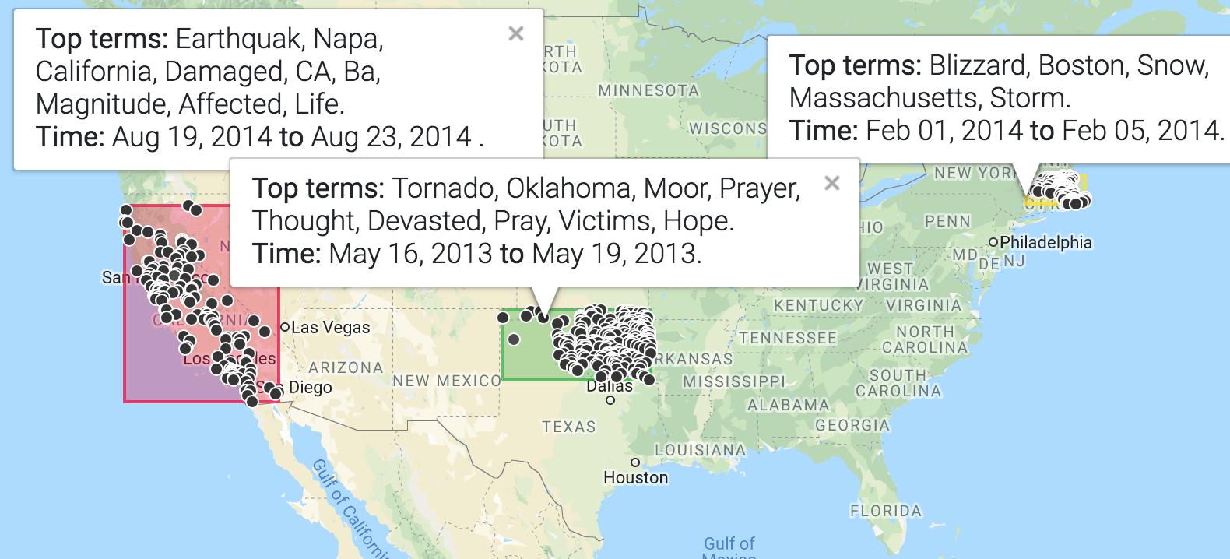


Relevance-driven Clustering for Visual Information Retrieval on Twitter
Mohamed Reda Bouadjenek, and Scott Sanner
Data-Driven Decision Making Lab, University of Toronto
Conference on Human Information Interaction and Retrieval, CHIIR’19.
(a) Baseline display showing all results.
(b) k-means based clustered results.
(c) Relevance-driven clustered results
Figure 1: (a) An interface for visual information retrieval in a multiyear Twitter corpus showing all geolocated tweets that match a query related to natural disasters. (b) A K-means clustered version of the same matching search results showing three clusters of tweets delineated by bounding boxes. Since K-means uses a compound distance metric that must trade off distance in time, space, and keyword content, its clusters often include unrelated content that is further exacerbated by the fact that K-means does not take into account relevance scores of content w.r.t. the query. For these reasons, while K-means does manage to find reasonable clusters in the data, one can see that the spatial and content coherency of the clusters can be improved. (c) A relevance and interface-driven clustered version of the same search results given by the proposed approach in this paper. In this case, one can readily identify three well-defined natural disasters from the clusters: (i) a blizzard in Boston in February 2014, (ii) a tornado in Oklahoma in May 2013, and (iii) an earthquake in California in August 2014.
Introduction
Search results of spatio-temporal data are often displayed on a map or other visual interface.
Displaying all relevant results would result in a saturated and unreadable display
Clustering can be used to organize spatio-temporal data, based on the cluster hypothesis. However, unsupervised clustering methods:
Do not guarantee that the clusters are relevant.
Require the design of a complex distance metric; i.e., space is often measured by Euclidean distance while keyword content is often measured by cosine distance and both of these distances need to be combined.
Do not necessarily guarantee the coherence of clusters from a visual, temporal and keyword content perspective.
Relevance-driven clustering is necessary to supply the users with highly relevant clusters representing different information perspective of their queries.
Optimization Algorithms
Visual Twitter Information Retrieval (Viz-TIR) is a tool based on a fast greedy algorithm that optimizes an approximation of an expected F1-Score metric to generate clusters.
We also developed a MILP based solution for benchmarking the greedy algorithm.
User Study
To determine whether our proposed relevance-driven EF1 optimization approach to clustering improves human search task performance in the Viz-TIR visual search interface (in comparison to k-means clustering and the non-clustering baseline), we performed an evaluation of 24 users who were given the task of searching for natural disasters in the previously described data. An analysis of their performance is provided in Figure 2, which shows that on average, users have higher recall on natural disaster types and locations as well as lower error estimating the time of the disaster using EF1 clustering in comparison to other methods.
Figure 2: The performance of the algorithms measured using cumulative recall for the type and location of the natural disasters and the absolute error in the dates of the disasters

